Slide 1
Welcome to
Lake Central High School’s
College-Bound Junior
Meeting
April 15, 2020

Slide 2
Lake Central High School
Guidance Staff
Counselors
Robin May (A-Braz)
Brynn Denton (Bren-Delg)
Melissa St. Clair (Deli-Geh)
Nicole Raber (Gei-Hui)
Jessica Sanchez (Huj-Lay)
Megan Truscott (Laz-Mone)
Lori Stasinski (Monf-Pies)
Ashley Kline (Piet-Sann)
Jamie Rodgers (Sano-Tink)
Tom Golumbeck (Tinl-Z)
Sean Begley, Principal
Melissa Rettig, Assistant Principal - Guidance
Laura Selin – Registrar
Sherrie Bereda, Naviance Secretary
Courtney Roberts, Secretary
Beth Toth, Data Secretary

Slide 3
Agenda
Explore colleges/universities
SAT/ACT
The college application process
Direct to University/Common APP
Request teacher recommendations
Request transcripts
Where to find scholarships
Additional information

Slide 4
What do you want to study? GPA/SAT/ACT/PSAT? Programs/activities?
Campus life? Opportunities? Scholarships?
App open date? Deadlines for scholarships? How to apply?
Research YOU
Research SCHOOLS
Admission Reps
Visits
Apply
Programs? Big/Small? In State? Distance? Cost?
SEE the campus. Make comparisons. Get a FEEL for the university.

Slide 5
Explore Colleges/Universities
College Fairs
  NACAC: National Fairs in Spring and Fall
  Local: Purdue Calumet, Merrillville HS, Crown Point HS, Valparaiso University, Lake Central
  College Visits
  Campus Visit Checklist
  Best time to visit is when school is in session
  **college videos, lots of information online, visit once accepted
  Bring back documentation for the Attendance Office
  Students are permitted two absences for College Visits

Slide 6
Explore Colleges/Universities
Representative Visits to Lake Central High School
By listing schools you are interested in, you will be notified through Naviance when that university representative will be visiting LCHS.
Visits are also announced on the Daily Announcements and via the @LCHS_Guidance Twitter account.

Slide 7
Naviance: What it has to offer
Students only!
student email and ID
Login issues: email sbereda@lcscmail.com
WITHIN NAVIANCE
ABOUT ME:Career Interest Profiler/Learning Style Inventory, Resume
COLLEGES: Supermatch, Scattegrams, Scholarships, College Acceptance, Letters of Recommendation
CAREERS: Roadtrip Nation, Explore Careers
PLANNER: Calendar, track deadlines

Slide 8
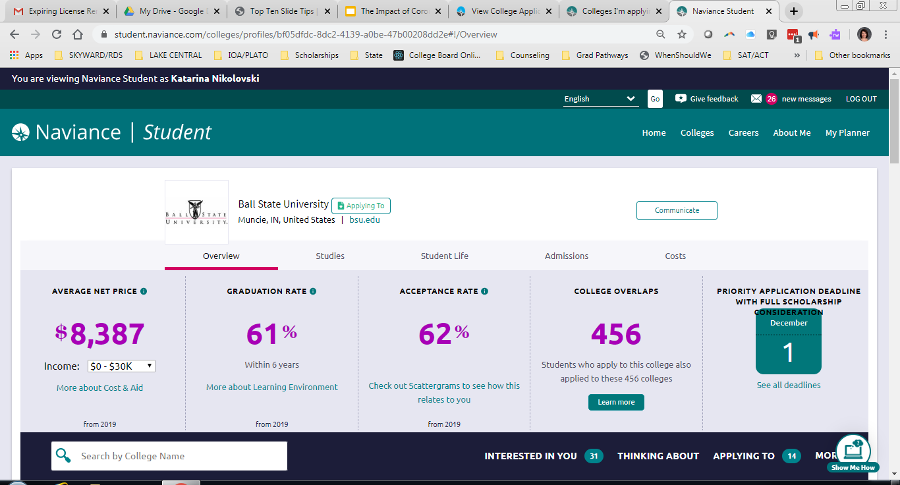

Slide 9
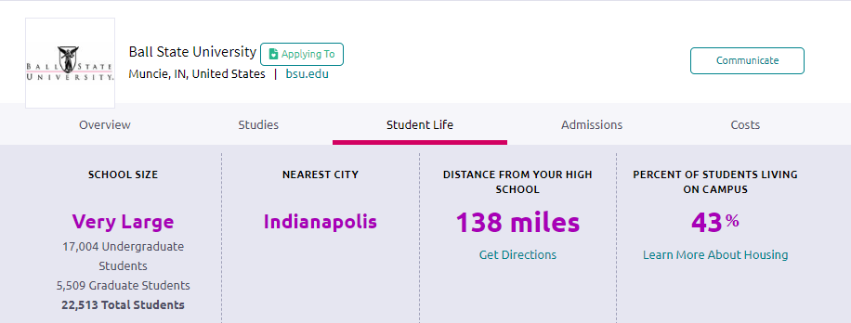
More Information Found On Naviance

Slide 10
Upcoming Video Meetings
Purdue WL- 4/20 at 12pm for seniors, 12:45pm for juniors, sign up here https://forms.gle/9mTa4D3WH5TxLeFd7
Purdue NW- 4/16 at 11am, juniors and seniors, sign up here https://forms.gle/oPaQGcQBh15wXx7j9
IUB- May 4, 2020 – Details to follow. Watch your email
IUN- Happened on 4/7. Kevin Smith is willing to video chat with students individually if the student wants
Ball State- 4/27 at 11am, juniors and seniors, sign up here https://forms.gle/LrodFuhuhQvD8Gx67
IUPUI- 4/17 at 11am, juniors and seniors, sign up here https://forms.gle/7gGBN3AJjw1qLtn68

Slide 11
ACT/SAT Prep and Exams
SAT – College Board
ACT – ACT.org
Times to take exam
Superscore
Which one should I take?
Prep work: Khan Academy/PSAT
6hrs-90 points
20hrs- 115 points
(16,000 students)

Slide 12
College Application Process
Average application fees range from $30-$100 (Students on free/reduced lunch may qualify for a waiver and should see their counselor)
Apply Direct to institution/Common App
Request teacher recommendations if needed
Request transcripts through Naviance NOT Parchment (Sept 1)
Counselors complete additional required reports

Slide 13
College Application Process
Complete the application through the college/university’s admission webpage or the Common Application
Many colleges/universities will create an account for the applicant and important information will be sent through THAT account.
Examples:
- Missing documents and acceptance

Slide 14
College Application Process
Students send ACT or SAT scores DIRECTLY from the testing agency (ACT.org or collegeboard.com)
If you want/need to send transcripts for any dual credits, they must be sent BY the college/university from which the credits were earned. (Ivy Tech, Vincennes, IUN, Purdue Northwest)

Slide 15
When to Apply
Application deadlines are posted on admissions websites for each college/university.
Purdue University: In order to be considered for merit-based scholarships and/or Early Action, student applications and all materials must be submitted by November 1st.
Indiana University Bloomington: Priority deadline for maximum scholarship consideration is November 1st.

Slide 16
The Common Application
One application used by over 800 colleges and universities – for example: Purdue West Lafayette, Notre Dame, University of Chicago, University of Michigan, Indiana University.
Butler and Valparaiso University use both the Common App and/or their own online application
Opens approximately August 1, 2020

Slide 17

The Common Application
It includes:
  5 lengthy student information sections
  Common App essay – ESSAY PROMPTS SAME AS 19-20
  Additional essays specific to schools to which the student is applying
  Counselor reports/evaluations

Slide 18
Common Application
DO NOT use your school email on any applications. Be smart with your email choice!
NEVER REQUEST LETTERS OF RECOMMENDATION THROUGH THE COMMON APP – ONLY REQUEST THROUGH NAVIANCE
The exact email/name listed on the Common Application is used to match with Naviance.
  Matching allows all the documents: transcripts, application, counselor secondary school report, recommendations, etc, to be “bundled” before sending.

Slide 19
ESSAY Prompts 20-21
1. Some students have a background, identity, interest, or talent so meaningful they believe their application would be incomplete without it. If this sounds like you, please share your story.
2. The lessons we take from obstacles we encounter can be fundamental to later success. Recount a time when you faced a challenge, setback, or failure. How did it affect you, and what did you learn from the experience?
3. Reflect on a time when you questioned or challenged a belief or idea. What prompted your thinking? What was the outcome?
4. Describe a problem you’ve solved or a problem you’d like to solve. It can be an intellectual challenge, a research query, an ethical dilemma — anything of personal importance, no matter the scale. Explain its significance to you and what steps you took or could be taken to identify a solution.
5. Discuss an accomplishment, event, or realization that sparked a period of personal growth and a new understanding of yourself or others.
6. Describe a topic, idea, or concept you find so engaging it makes you lose all track of time. Why does it captivate you? What or who do you turn to when you want to learn more?
7. Share an essay on any topic of your choice. It can be one you’ve already written, one that responds to a different prompt, or one of your own design.

Slide 20
Request Teacher Recommendations
It is good etiquette to personally ask the teacher for recommendation prior to requesting the it through Naviance.
It is ALSO good etiquette to give your recommender at least two weeks to write the letter.
With Naviance, if a school only required ONE letter of recommendation, the first one submitted is the one that is sent to that university.
Teachers cannot upload letters until approximately August 15th.
If you don’t a letter, DON’T ASK FOR ONE!

Slide 21

Request Teacher Recommendations
If the recommendation is for a scholarship that requires them to mail in their recommendation, provide the recommender with an envelope/stamp and address of where to send the letter.

Slide 22
Important Information!!!
Document requests (letters of rec, counselor recommendations, transcripts etc) need to be submitted no later than Wednesday, Oct. 14th to ensure they will be submitted by Nov 1 deadline.
All Transcript requests for colleges/universities need to be requested through Naviance.
Login issues: contact Mrs. Bereda at
sbereda@lcscmail.com

Slide 23
BLOG: www.lcguidance.blogspot.com
Where to find Scholarships –
Naviance under Colleges Home Page
Google search
Parents employer
College website
Twitter/Instagram - @LCHS_Guidance
Scholarships
Deadlines
Scheduling
Events
News

Slide 24
NCAA Eligibility Center
NAIA.org
Financial Aid Nights

