Slide 1
What You
Need to Know
About Financial Aid

Slide 2
Topics We Will Discuss
What is financial aid?
Cost of attendance (COA)
Student aid index (SAI)
Financial need
Categories, types, and sources of financial aid
Free Application for Federal Student Aid (FAFSA®)
Special and unusual circumstances

Slide 3

What Is Financial Aid?
Financial aid consists of funds provided to students and families to help pay for postsecondary educational expenses

Slide 4




What Is Cost of Attendance (COA)?
Tuition and fees
Housing and food
Books and supplies
Transportation
Miscellaneous and personal

Slide 5
EFC to SAI
Previous
Expected Family Contribution (EFC)
Ranges from 0 to 999999
Starting 2024-25 FAFSA
Student Aid Index (SAI)
Ranges from -1500 to 999999
Index
Student Income
Parent(s) Assets
Student Assets
Parent(s) Income
Index used by the college to determine the financial aid offer
Notes:
FAFSA index changes from the EFC (Expected Family Contribution) to the SAI (Student Aid Index), which can be a negative number. Highlight the fact that this is an index used by the college to determine eligibility for various types of aid remains the same.

Slide 6
What Is Student Aid Index (SAI)?
Number resulting from the evaluation of a student’s (and family’s) approximate financial resources for a student’s postsecondary education
Student contribution
Parent contribution
(for dependent students)

Slide 7
What Is Financial Need?
Cost of attendance (COA) – Student aid index (SAI) = Financial need

Slide 8
Categories of Financial Aid
Need-based aid
Non-need-based aid

Slide 9
Types of Financial Aid
Scholarships
Grants
Loans
Work-Study Employment
Self-Help Aid
Gift Aid

Slide 10
Sources of Financial Aid
Federal Government
Employers
States
Private Sources
College and Universities

Slide 11
Federal Government
Largest source of financial aid
Aid provided primarily based on financial need
Must apply each year using the FAFSA
Eligibility requirements must be met

Slide 12
Federal Student Aid Programs
Federal Pell Grant
Federal Supplemental Educational Opportunity Grant (FSEOG)
Teacher Education Assistance for College and Higher Education (TEACH) Grant
Federal Work-Study (FWS)
Federal Direct Student Loans (Direct Loans)
Federal PLUS Loans

Slide 13
States
Residency requirements usually apply
Aid may be provided based on
both merit and need
Use information from the FAFSA and/or state aid applications
Deadlines vary by state

Slide 14

April 15th FAFSA Deadline
21st Century Scholarship
Frank O’Bannon Grant
Mitch Daniels Early Graduation Scholarship
Credit Completion Requirement
  Full-time enrollment
  Dual Credit
Satisfactory Academic Progress

Slide 15
Colleges and Universities
Aid provided based on both merit and financial need
Aid may be gift aid or self-help aid
Use information from the FAFSA and/or institutional applications
Deadlines and application requirements vary by institution

Slide 16
Private Sources
Foundations, businesses, churches, civic,
and charitable organizations
Deadlines and applications procedures vary
Begin researching private sources early

Slide 17
Employers
May have scholarships available
to the children of employees
May have educational benefits for their employees

Slide 18

Federal Student Aid Estimator
Early estimation regarding SAI and possible Title IV aid available
Requires demographic, income, and asset information
https://studentaid.gov/aid-estimator

Slide 19
Free Application for Federal Student Aid (FAFSA®)
Collects demographic and financial information
Information used to calculate the student aid index (SAI)
Colleges use SAI to offer financial aid
Available in English and Spanish

Slide 20
Free Application for Federal Student Aid (FAFSA®)
May be filed at any time during an academic year, but typically no earlier than October 1st prior to the academic year for which the student requests aid
For the 2024-25 academic year, the FAFSA may be filed starting in December 2023 (exact date to be determined)
Colleges may set FAFSA priority dates

Slide 21



Free Application for Federal Student Aid (FAFSA®)
Online FAFSA
PDF FAFSA
FAFSA on the Phone (FOTP)

Slide 22
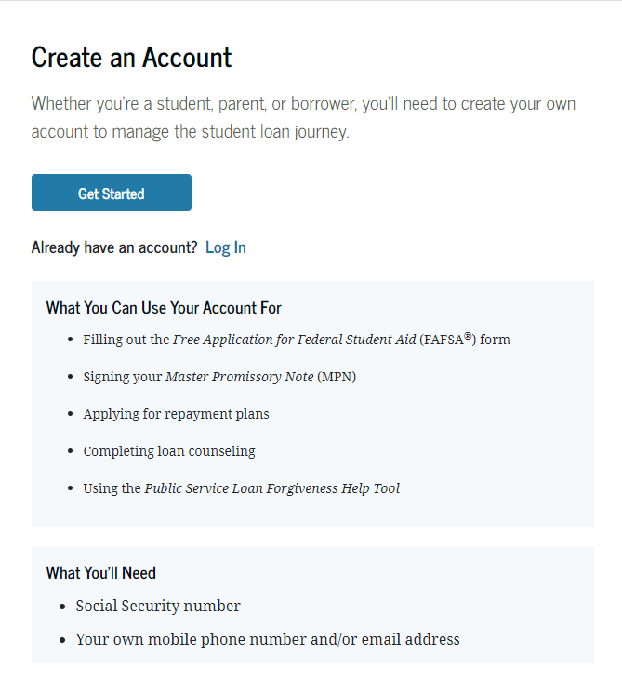
Account Username and Password (FSA ID)
Used for FAFSA completion
and access to certain U.S. Department of Education websites
Student and parent must
create own FSA ID
May be used throughout
financial aid process,
including subsequent
school years
Only the owner should
create an FSA ID
Apply at https://studentaid.gov/fsa-id/create-account/launch

Slide 23
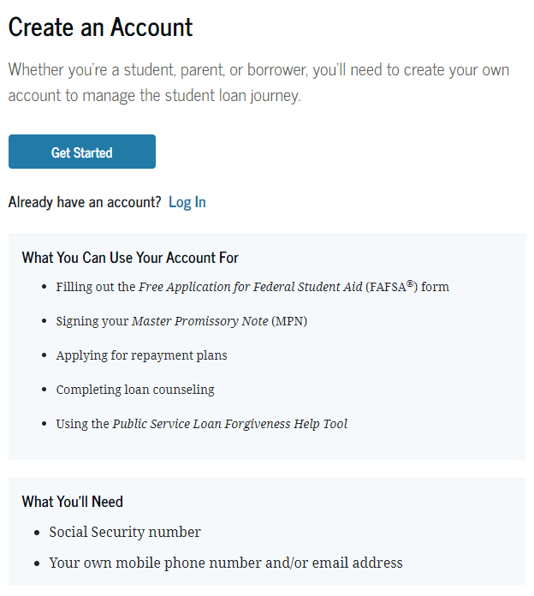
FSA ID Required
Create account at: studentaid.gov
  Account required & unique to each person/contributor
    Person with SSN – confirmed through SSA
    Person without SSN – confirmed through new match with credit bureau (available soon)
Alert: FSA ID must be set up & confirmed before filing the FAFSA due to consent requirement
Notes:
Reminder that FSA ID is unique to an individual and that student needs an account as well as each contributor – parent(s)
Encourage counselors to reinforce that student needs to create their own and parent creates their own. Should never create an account for someone else
If parent has an account already, they don’t need to create a new one
We’ll discuss whether one or both parents need an ID later in presentation
Highlight that individuals with or without SSN’s can and are required to get FSA ID’s now. People with an SSN are confirmed through the Social Security Administration (2-3 days). People without an SSN will be confirmed through a new credit bureau match. This process is still being worked on, so isn’t currently available but will be soon.
Assume question of whether this allows undocumented students without SSN to get an FSA ID and file the FAFSA. Student still has to be a US Citizen or eligible non-citizen at this point.
On click: Alert that the FSA ID needs to be set up and confirmed prior to filing the FAFSA due to the new required consent. If FAFSA filed before ID confirmed, consent cannot be given, thus FAFSA will be rejected, and no eligibility determined. Individual contributor will have to go back in to the FAFSA and update it to provide consent and resubmit for proper processing.

Slide 24
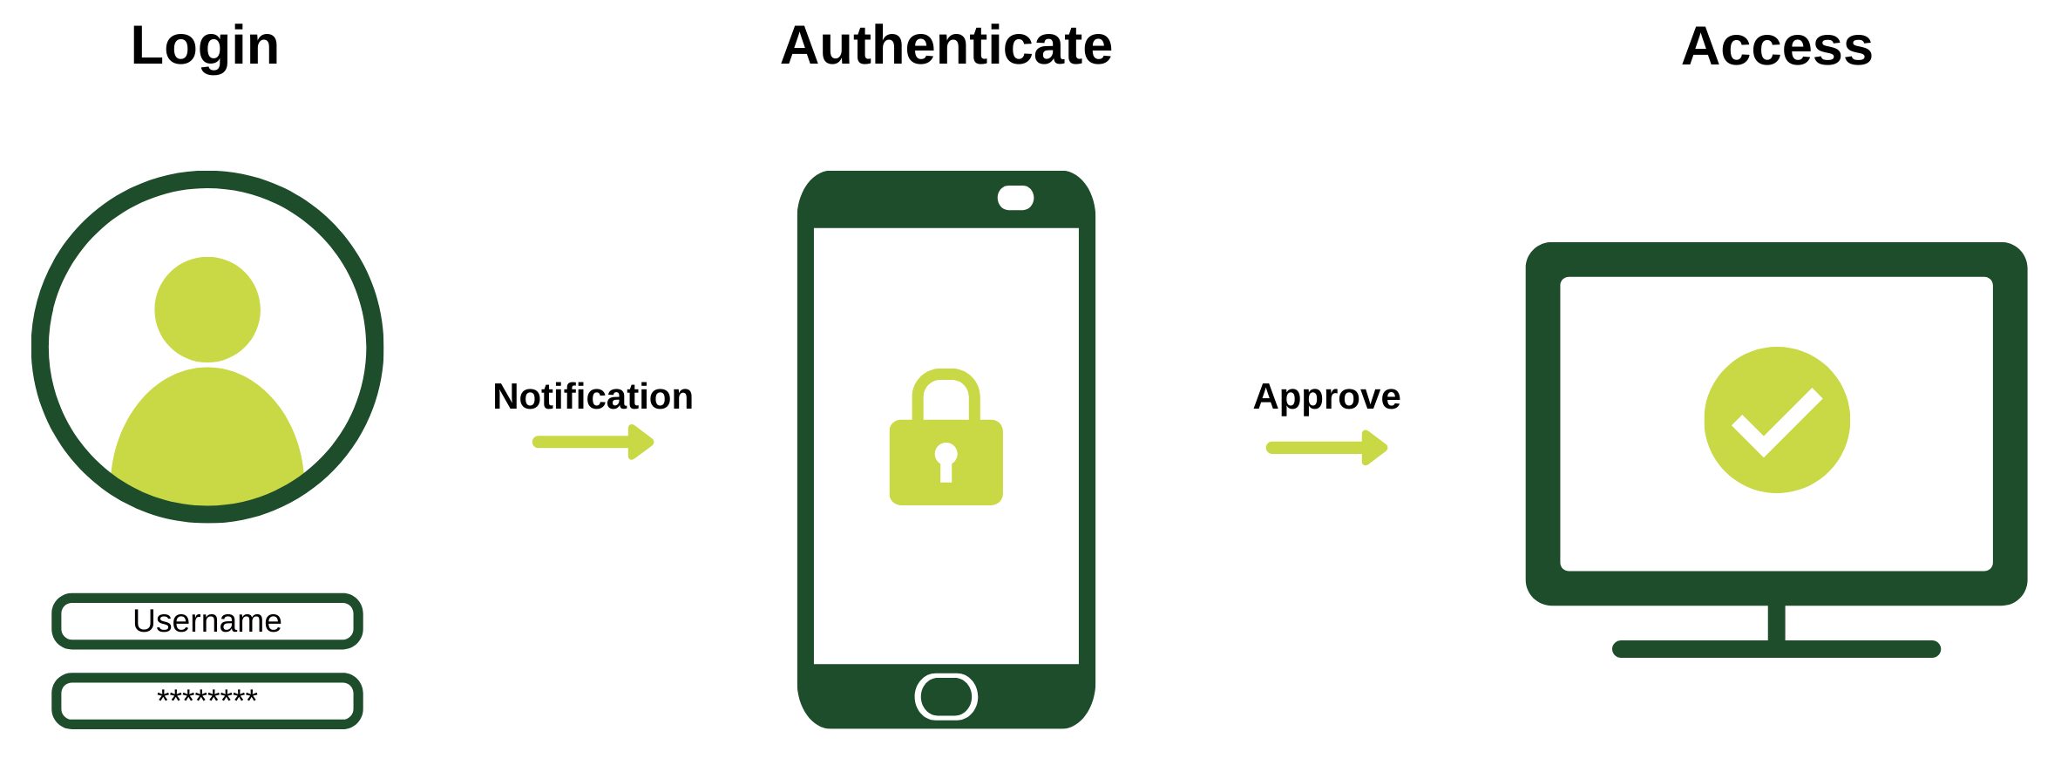
FSA ID
2-Step Verification
FSA ID Reminders
Account authenticated each time the FSA ID is used
Forgot username and/or password?
  Access regained through linked email or mobile phone
    Challenge questions also an option but access is delayed
Notes:
Simple reminder that FSA ID’s go through the 2-step verification each time they are used. Contributor logs in with username/password then authenticates through email, phone, or authenticator app
If person forgets their username or password, they can recover the username or reset the password through a linked email or mobile phone. Can use challenge questions, but still 30 min delay before it can be used if password reset.

Slide 25


IRS DRT to FADDX
2023-24 and before
2024-25 and beyond
IRS Data Retrieval Tool
  Tax filer had option to link to IRS to pull tax info into FAFSA
  Required
    FSA ID
    Address from appropriate tax year’s taxes
    Sometimes a little luck
Future Act Direct Data Exchange (FADDX)
  Tax information pulled directly from IRS by U.S. Department of Education behind the scenes
  Required
    FSA ID
    Consent
Notes:
Compares the IRS DRT to the new FADDX (animation shows IRS DRT then on click shows FADDX)
Note: Consent discussed on next slide and FSA ID in future slides

Slide 26
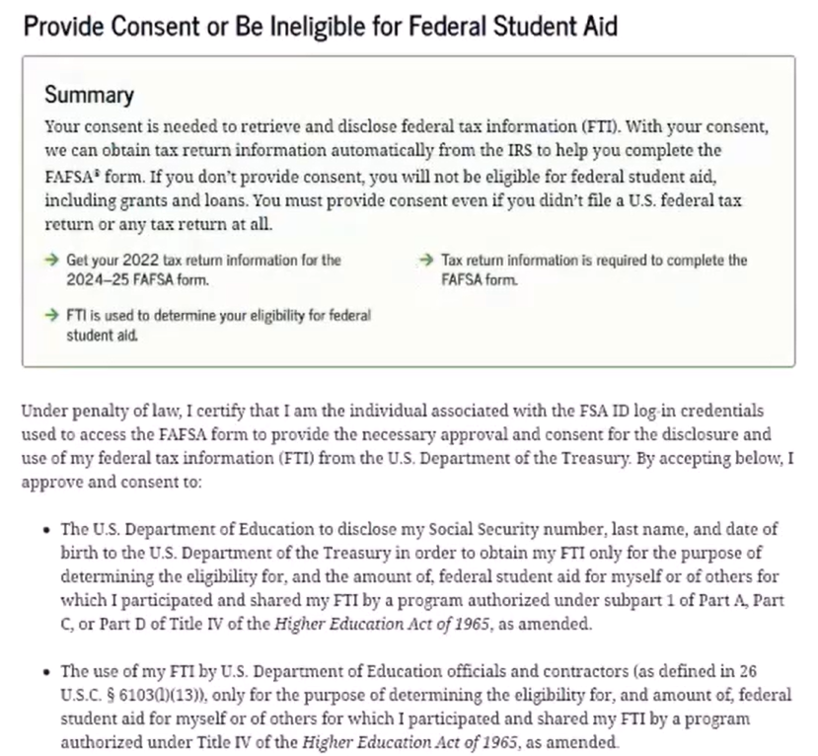
Consent is REQUIRED
Regardless of whether the student and/or parent(s) filed taxes, consent is required for everyone!
  NO consent = NO federal or state financial aid eligibility
  FAFSA will reject & no SAI will be calculated
Notes:
Reinforce that consent is required for federal or state aid eligibility. The new exchange with IRS required a higher level of protection of data as well as consent to even request the information.
Assuming most institutional merit based financial aid will still be available, but that is a decision based on each institutional policy.

Slide 27
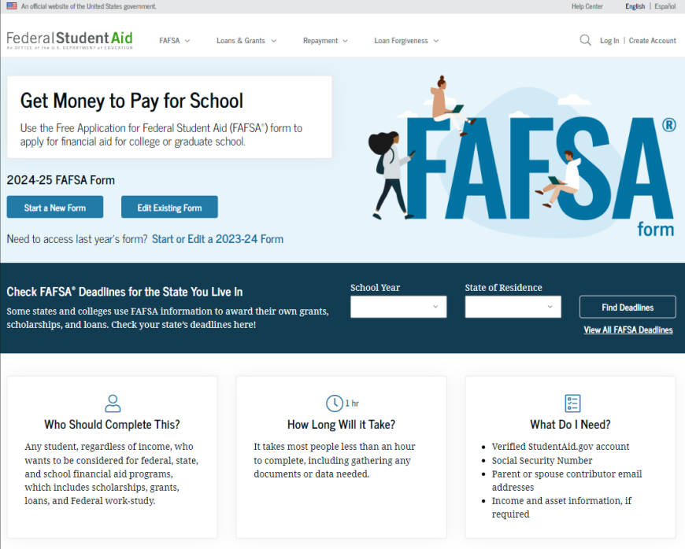
Online FAFSA
Note: Online FAFSA screenshots from U.S. Department of Education’s 2024-25 FAFSA Form Preview Presentation, July 2023

Slide 28
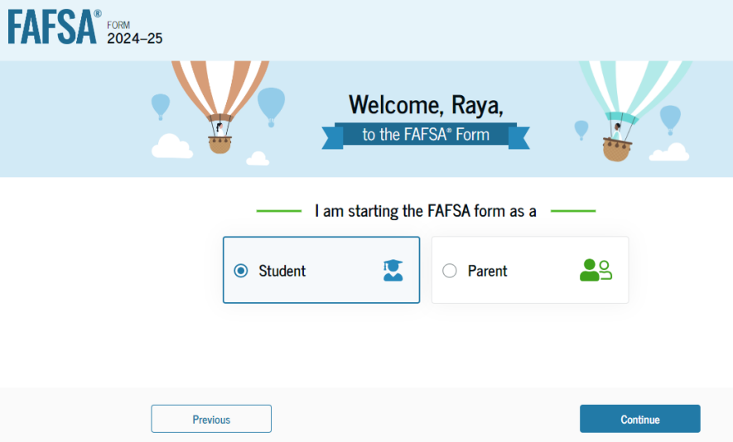
Online FAFSA

Slide 29
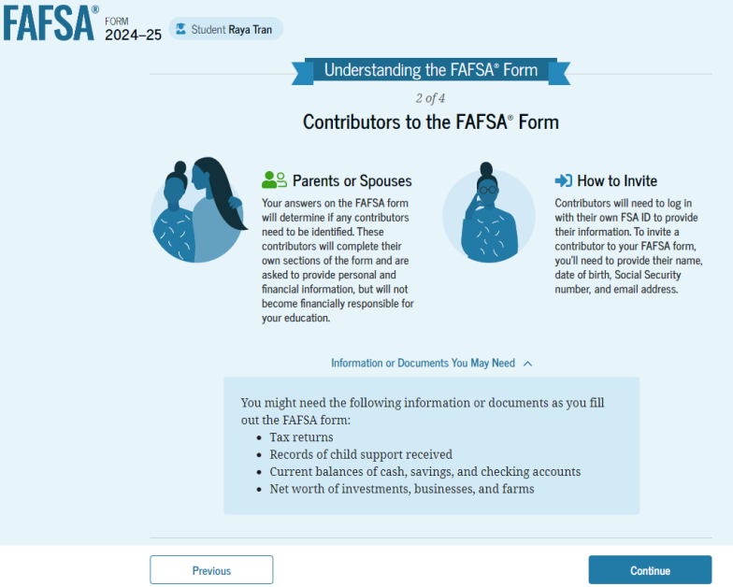
FAFSA Contributors

Slide 30
Who is the Parent?
Biological or adoptive parents
Married or unmarried & living together
Divorced, separated or unmarried & not living together
Widowed &
not remarried
Who provided more financial support the last 12 months?
If equal, which parent has the greater income & assets the last 12 months?
Both parents listed on the FAFSA
If parent single, then only person listed on the FAFSA
If parent remarried, then parent & step-parent listed on the FAFSA
Single parent listed on the FAFSA
Notes:
Grid that talks about who is a Parent and the change for the 2024-25 FAFSA
Reiterate that no one can be a parent if they aren’t biological parent or adopted the student.
Click 1 will show 3 marital status options
Click 2 shows answer if married/unmarried & living together
Click 3 shows answer if divorced, separated or unmarried and not living together – Reinforce change to who provided more financial support and if equal, it is who has the greater income and assets.
Click 4 shows answer if widowed & not remarried

Slide 31
Student Information
Identity and contact information
Consent for FTI transfer from IRS
Marital status
College plans
Personal and unusual circumstances

Slide 32
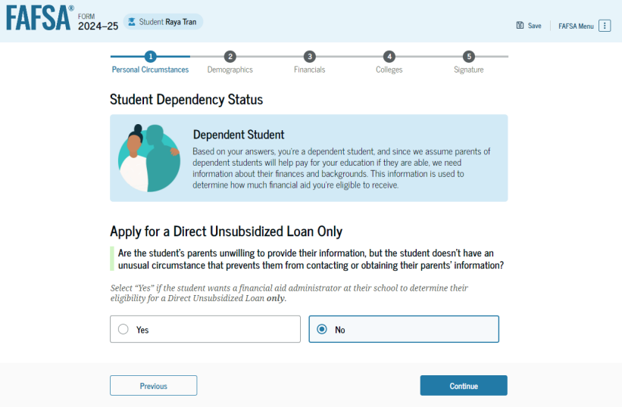
Student Dependency Status

Slide 33

Provisional Independent Status
Once identified as provisional independent student:
  Continue FAFSA like an independent student
  No parental questions
  Receive a provisional SAI & eligibility
  Instructed to work with college financial aid administrator for final determination.
Notes:
If no designation for unaccompanied/homeless youth OR yes to unusual circumstance, then result is provisional independent student status which means they finish FAFSA as if independent with no parental questions. Then receives a provisional SAI and eligibility along with a notification to work with their college financial aid administrator as it is up to them whether the student is truly independent or will need to update the FAFSA as a dependent student with parental information.

Slide 34
Unusual Circumstances
Conditions that justify an institution making an adjustment to a student’s dependency status
Student does not provide parental data on FAFSA
    Considered provisionally independent
Student follows institution’s process for dependency override determination

Slide 35
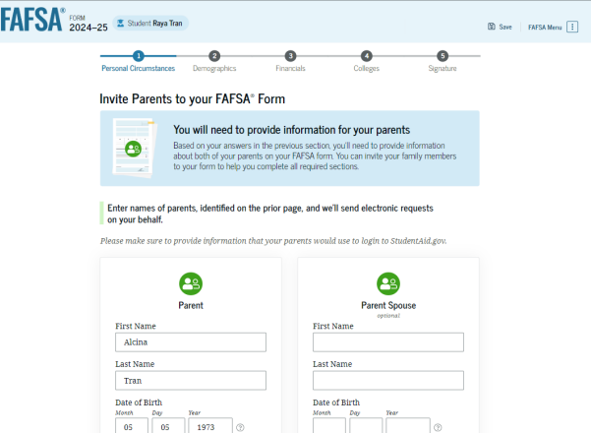
Student Invites Parents to FAFSA
Student provides personal information about parents to invite them to complete parent portion of the FAFSA

Slide 36
Student Information
Demographic information
Citizenship status
Parents’ education status
Parent killed in line of duty
High school information

Slide 37
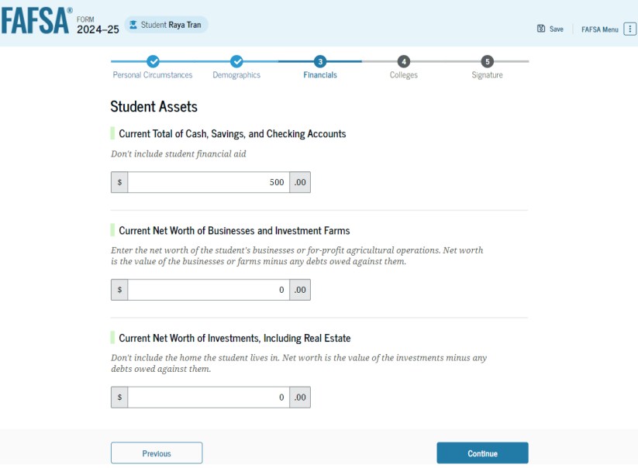
Student Financial Information
Tax return information
  Minimal questions if FTI transferred from IRS
Asset information

Slide 38
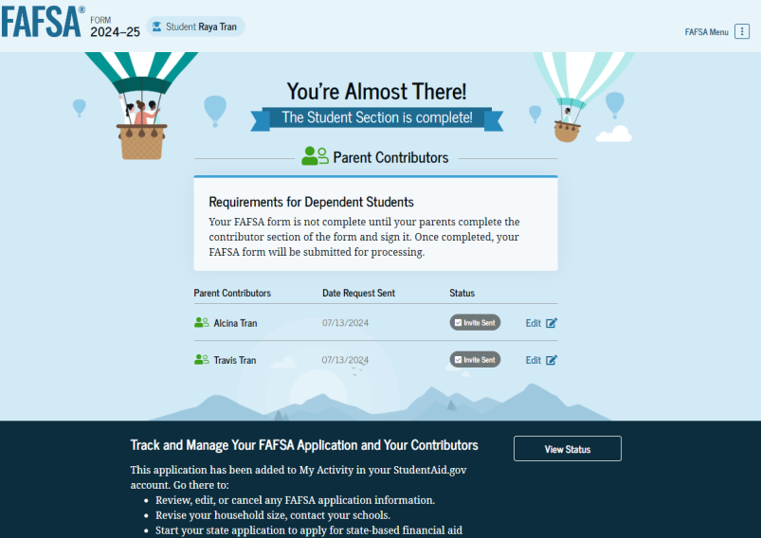
Student Section Completion
College selection
Review of information
Signature

Slide 39
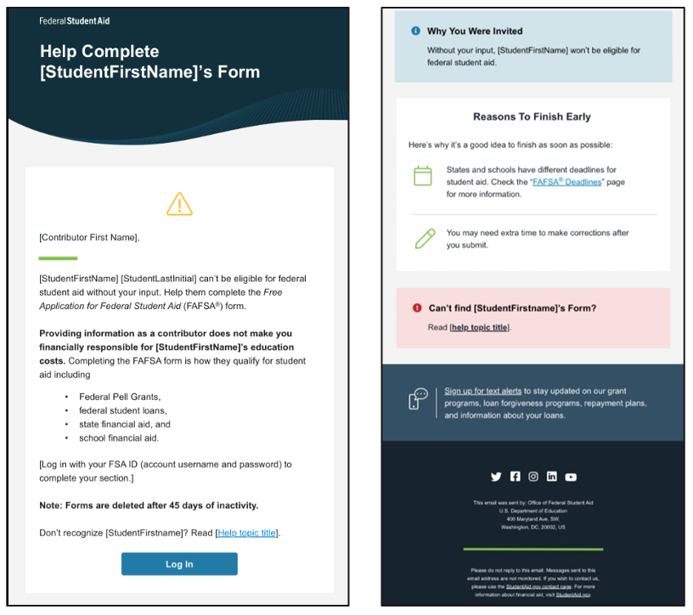
Sample Invitation Email
Provides the student’s name
Indicates the student can’t be eligible for federal student aid without this contributor’s data
Confirms that providing info does NOT make the contributor financially responsible
Link to login & get started
Notes:
Review sample email to help counselors understand the process. Reiterates who the student is, why the contributor’s information is required, and that providing information doesn’t equate to financial responsibility.

Slide 40
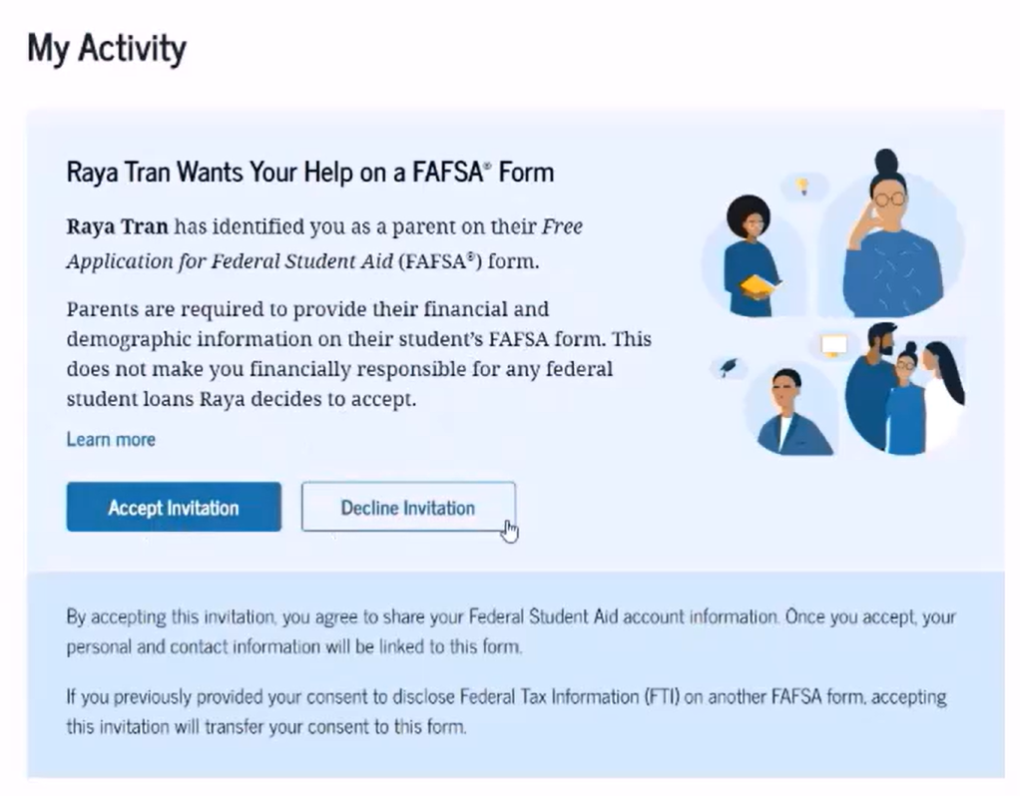
Parent Status Screen
Parent access
  Clicks link in invitation email
  Login with FSA ID
  Taken to “My Activity” page
  Accept or decline the invitation
    If accept, then confirmation of agreeing to share info
    If decline, presented an opportunity to reconsider
Notes:
Once parent receives invitation email, they click the link, login with their FSA ID then see the My Activity page where they can accept or decline the invitation. If they accept the invitation, a confirmation box appears to confirm that they agree to share their information. If they decline the invitation, a box appears providing the option go back and accept or continue to decline the invitation.

Slide 41
Parent Information
Identity and contact information
Consent for FTI transfer from IRS
Marital status
State of legal residence

Slide 42
FADDX & Contributors
Marital status & tax filing status still impacts information required
  Married filing joint 2022 tax return with current spouse
    1 contributor section, 1 consent, & combined tax info transferred via FADDX
  Married filing separate 2022 tax returns
    2 contributor sections, 2 consents & separate tax info transferred via FADDX
  Single filing a 2022 tax return with a “single” type tax filing status
    1 contributor section, 1 consent, & tax info transferred via FADDX
Notes:
Reiterate that tax information is being transferred behind the scenes once consent is provided. Who needs to be included as a contributor so that their financial/tax info is included depends on the marital status and tax filing status as in the past.
Walk through three general scenarios on slide. FYI- “Single” type tax filing status is not just single, but HH, etc.

Slide 43

FADDX & Contributors
What if tax information can’t be retrieved or individual’s situation isn’t eligible for FADDX
  Additional questions displayed to determine if contributor did file a tax return
    If yes, income and tax field provided for manual entry by the contributor
    If no, then continue to next questions on the FAFSA.
Reminder: Consent is still required even if taxes weren’t filed.
Notes:
Slide meant to discuss what happens if person didn’t file taxes, if tax information can’t be retrieved, identity theft issue, or tax filing status different than marital status. Bottom line is that consent is required no matter what and tax information not retrievable, then manual entry questions provided.

Slide 44
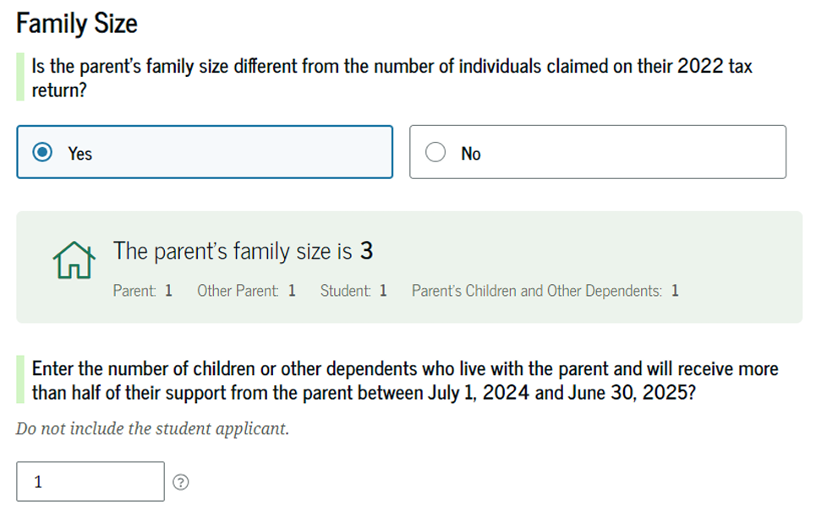
Family Size
Family size determined from individuals claimed on 2022 tax return
  Option provided to change family size if tax return doesn’t reflect current situation
  Tax return info is protected data & not shown to the contributor
4
Notes:
Explain that family size will be transferred from taxes based on individuals claimed. Contributor will be asked if the family size is different than the # claimed on 2022 taxes. Explain that this number won’t be provided due to rule requiring protection of FTI. If not the same, then the information can be updated.

Slide 45

Number in College
No impact on the FAFSA
  Question is asked on the FAFSA, but its not used in the SAI calculation
  Schools may elect to consider a family’s situation on a case-by-case basis, but this is an individual college’s decision.
Notes:
Highlights for counselors that the number in college will be asked, but no longer impacts the FAFSA calculation. Mention that colleges may choose to consider the impact of multiple students in college and adjust the FAFSA based on documentation provided but this must me done on a case-by-case situation.

Slide 46
Parent Financial Information
Receipt of means-tested federal benefits in the previous two years
Tax filing status
Family size and number in college
Tax return information
  Minimal questions if FTI transferred from IRS
Assets
Other parent information

Slide 47
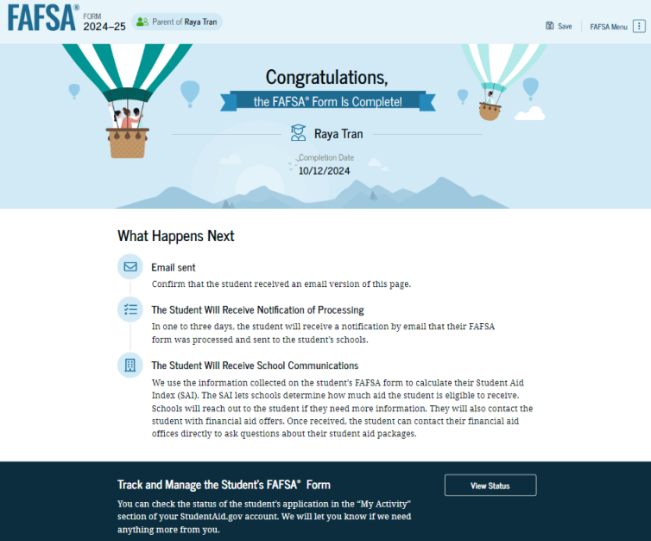
Parent Section Completion
Review of information
Signature and submission of FAFSA

Slide 48
Miscellaneous Notes
Each contributor signs & submits their section. Last contributor to complete also submits the FAFSA form.
  Student receives an email when form complete & submitted
Student can track their application status on the studentaid.gov dashboard under “My Activity” area.
Contributors can only see their submitted info, unless it is the student, who can see all info.
  Data transferred from IRS is protected and no contributor can view it.
Notes:
Miscellaneous pieces of information. This slide talks about how each contributor signs and submits their section. The last to finish also submits the FAFSA. The student (applicant) gets an email when the form has been completed and submitted.
Student can track status by logging into studentaid.gov using their FSA ID.
Reinforces that since this is the student’s application they can see all contributors’ info, which parent(s) can only see their section. However, due to FTI rules, any financial/tax information transferred is hidden even from student.

Slide 49
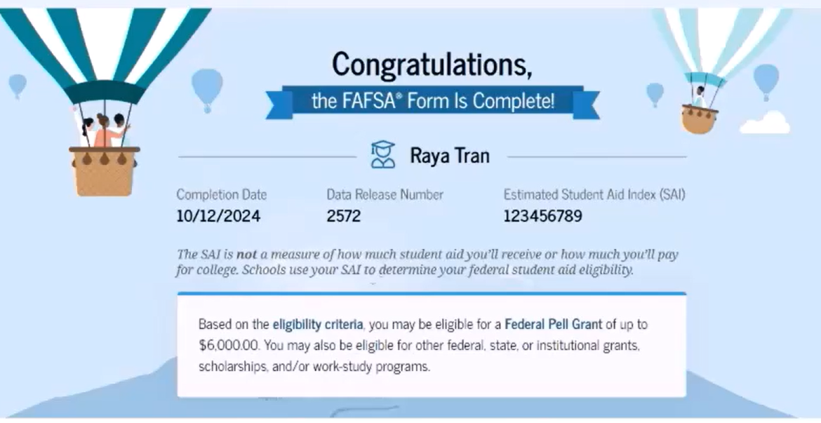
Student Confirmation Page Sample
Notes:
Simply a pic of the student’s confirmation page that shows date, SAI and statement of possible eligibility. Parent contributor confirmation doesn’t provide all of this information.

Slide 50
Miscellaneous Notes
Students can list up to 20 schools to receive their FAFSA data
Colleges/Universities required to inform students of opportunities, the process, & required documentation for:
  Special circumstances – situations that potentially justify a change to the FAFSA
  Unusual circumstances – conditions that potentially change the student’s dependency status
    Independent determination carries forward to subsequent years unless there is reason to believe the situation has again changed.
Notes:
A few other miscellaneous items:
Students can list up to 20 schools now
Colleges are required to inform students of PJ opportunities, the process and required documentation. We separate out the special circumstances and unusual circumstances. Also highlight that if dependency override is done, it carries forward unless there is reason to believe the situation has changed.

Slide 51
Other Considerations
If independent student is married, spouse information is required as well
Consent to transfer FTI from the IRS is required for ALL contributors
  Including student, student’s spouse (if applicable), parent, and other parent (if applicable)
Students, parents, and preparers may start, complete, and submit a FAFSA

Slide 52



FAFSA Processing Results
FPS
College
Student

Slide 53
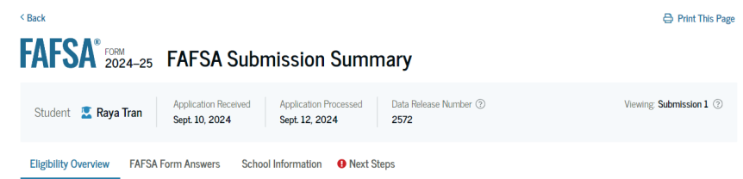
FAFSA Submission Summary
Four sections:
  Eligibility Overview
  FAFSA Form Answers
  School Information
  Next Steps
Ability to print summary

Slide 54
Institutional Student Information Record (ISIR)
FPS sends results to colleges listed on the FAFSA
College reviews ISIR and may request additional documentation

Slide 55
Making Corrections
If necessary, corrections to FAFSA data may be made by:
Using online FAFSA;
Updating paper FAFSA Submission Summary; or
Submitting documentation to college’s financial aid office.

Slide 56
Special Circumstances
Different than unusual circumstances (dependency overrides)
Unique conditions exist that cannot be documented with the FAFSA, or circumstances have changed since filing
Student should contact institution’s financial aid office for more information
Decisions are final and cannot be appealed to U.S. Department of Education

Slide 57

Special Circumstances
Unusual uncovered medical/dental expenses
Secondary school tuition
Extraordinary dependent care
Parent or spouse death
Additional family members in college
Loss of employment or income
Divorce

Slide 58

College Goal Sunday
Date for 2024
February 25, 2024
Time: 2 – 4 pm (Local Time)
Celebrating over 30 years of helping Hoosier families file the FAFSA!
CollegeGoalSunday.org

